Slide 1
Unit testing
(With a dash of API design)
May 2018
Forwards Teaching Team

Slide 2
Motivation

Slide 3
Let’s add a column to a data frame
# Write a function that allows us to add a
# new column to a data frame at a specified
# position.
add_col(df, "name", value, where = 1)
# Start simple and try out as we go

Slide 4
Your turn
# A useful building block is add_cols() -
# works like cbind() but can insert anywhere
add_cols <- function(x, y, where = 1) {
if (where == 1) { # first col
...
} else if (where > ncol(x)) { # last col
...
} else {
...
}
}

Slide 5
A first attempt
add_cols <- function(x, y, where = 1) {
if (where == 1) {
cbind(x, y)
} else if (where > ncol(x)) {
cbind(y, x)
} else {
cbind(x[1:where], y, x[where:nrow(x)])
}
}

Slide 6
Actually correct
add_cols <- function(x, y, where = 1) {
if (where == 1) {
cbind(y, x)
} else if (where > ncol(x)) {
cbind(x, y)
} else {
lhs <- 1:(where - 1)
cbind(x[lhs], y, x[-lhs])
}
}

Slide 7
A common workflow
# Create some simple inputs
df1 <- data.frame(a = 3, b = 4, c = 5)
df2 <- data.frame(X = 1, Y = 2)
# After tweaking the function, re-run these cases
add_cols(df1, df2, where = 1)
add_cols(df1, df2, where = 2)
add_cols(df1, df2, where = 3)
add_cols(df1, df2, where = 4)

Slide 8
Two challenges
Duplication/unsaved changes
Looking at the outputs of each run is tedious

Slide 9
We need a new workflow!
Duplication/unsaved changes
Create a formal suite of unit tests
Looking at the outputs of each run is tedious
Use devtools::test() to run & check

Slide 10
Testing workflow
http://r-pkgs.had.co.nz/tests.html

Slide 11
So far we’ve done this:
Write R code
Reload code
Cmd/Ctrl + Shift + L
devtools::load_all()
Explore in console

Slide 12
Testthat gives a new workflow
Write R code
Reload code
Cmd/Ctrl + Shift + L
devtools::load_all()
Run automated tests
Cmd/Ctrl + Shift + T
devtools::test()

Slide 13
But why load the code?
Write R code
Run automated tests
Cmd/Ctrl + Shift + T
devtools::test()

Slide 14
We know how to create a package
usethis::create_package("~/desktop/addcol")
usethis::use_r("add_col")
# add_cols <- function(x, y, where = 1) {
# if (where == 1) {
# cbind(y, x)
# } else if (where > ncol(x)) {
# cbind(x, y)
# } else {
# lhs <- 1:(where - 1)
# cbind(x[lhs], y, x[-lhs])
# }
# }

Slide 15
Now add tests
usethis::use_test()
✔ Adding 'testthat' to Suggests field
✔ Creating 'tests/testthat/'
✔ Writing 'tests/testthat.R'
✔ Writing 'tests/testthat/test-add_cols.R'
● Modify 'tests/testthat/test-add_cols.R'
devtools::test()
# Or Command + Shift + T
Set up testthat inafrastructure
Create test file matching script

Slide 16
Key idea of unit testing is to automate!
at_pos <- function(i) {
add_cols(df1, df2, where = i)
}
expect_named(at_pos(1), c("X", "Y", "a", "b", "c"))
expect_named(at_pos(2), c("a", "X", "Y", "b", "c"))
expect_named(at_pos(3), c("a", "b", "X", "Y", "c"))
expect_named(at_pos(4), c("a", "b", "c", "X", "Y"))
Helper function to reduce duplication
Describes an expected property of the output

Slide 17
And this automation must follow conventions
Tests for R/add_cols.R
# In tests/testthat/test-add_cols.R
test_that("can add column at any position", {
at_pos <- function(i) {
add_cols(df1, df2, where = i)
}
expect_named(at_pos(1), c("X", "Y", "a", "b", "c"))
expect_named(at_pos(2), c("a", "X", "Y", "b", "c"))
expect_named(at_pos(3), c("a", "b", "X", "Y", "c"))
expect_named(at_pos(4), c("a", "b", "c", "X", "Y"))
})

Slide 18
Tests are organised in three layers
File
One per .R file in R/
Hard to define precisely. One per “chunk” of functionality.
Test
Test
Expectation
Expectation
Test
Expectation
Expectation
Expectation
Expectation
Expectation
Expectation
Expectation
Expectation
Expectation
Very fine grained
Test
Expectation
Expectation
Expectation

Slide 19
Practice the workflow
Copy in your add_cols() function.
Create an add_cols() test file using use_test().
Put the previous expectations in a test case.
Verify that the tests pass with Cmd + Shift +T.
Add test using where = -1. Verify that it fails.

Slide 20
Why test?

Slide 21

https://unsplash.com/photos/TL5Vy1IM-uA
Writing tests improves your API

Slide 22

Improve readability or performance without changing behaviour.
https://unsplash.com/photos/gYBMinOlAUE

Slide 23

https://unsplash.com/photos/y02jEX_B0O0
When you stop work, leave a test failing

Slide 24

https://unsplash.com/photos/AVRxWIsK9Jk
If you’re bored in this class, write tests!

Slide 25
Test-driven Development

Slide 26
Next challenge is to implement add_col
df <- data.frame(x = 1)
add_col(df, "y", 2, where = 1)
add_col(df, "y", 2, where = 2)
add_col(df, "x", 2)
We’ll use test-driven development to write add_col such that it passes required tests.

Slide 27
Four expectations cover 90% of cases
expect_equal(object, expected)
expect_error(code, regexp)
expect_warning(code, regexp) expect_warning(code, NA)
expect_known_output(code)

Slide 28
Make these tests pass
# use_test("add_col")
test_that("where controls position", {
df <- data.frame(x = 1)
expect_equal(
add_col(df, "y", 2, where = 1),
data.frame(y = 2, x = 1)
)
expect_equal(
add_col(df, "y", 2, where = 2),
data.frame(x = 1, y = 2)
)
})
# Some hints on next slide

Slide 29
Hints
# Start by establishing basic form of the
# function and setting up the test cases.
add_col <- function(x, name, value, where = 1) {
}
# Make sure that you can Cmd + Shift + T
# and get two test failures before you
# continue
# More hints on the next slide

Slide 30
More hints
# Write the body of add_col(), using add_cols() to do most of the
# work
# add_cols() takes two data frames and
# you have a data frame and a vector
# setNames() lets you change the names of
# data frame

Slide 31
A solution
add_col <- function(x, name, value, where) {
df <- setNames(data.frame(value), name)
add_cols(x, df, where = where)
}

Slide 32
Make this test pass
test_that("can replace columns", {
df <- data.frame(x = 1)
expect_equal(
add_col(df, "x", 2, where = 2),
data.frame(x = 2)
)
})

Slide 33
A solution
add_col <- function(x, name, value, where) {
if (name %in% names(x)) {
x[[name]] <- value
x
} else {
df <- setNames(data.frame(value), name)
add_cols(x, df, where = where)
}
}

Slide 34
Make this test pass
test_that("default where is far right", {
df <- data.frame(x = 1)
expect_equal(
add_col(df, "y", 2),
data.frame(x = 1, y = 2)
)
})

Slide 35
A solution
add_col <- function(x, name, value,
where = ncol(x) + 1) {
if (name %in% names(x)) {
x[[name]] <- value
x
} else {
df <- setNames(data.frame(value), name)
add_cols(x, df, where = where)
}
}

Slide 36
Can we use add_col() to remove columns?
df <- data.frame(x = 1, y = 2)
expect_equal(
add_col(df, "x", NULL)
data.frame(y = 2)
)
# Should we?
# Would remove_col() be better?

Slide 37
Can we use add_col() to move columns?
df <- data.frame(x = 1, y = 2)
expect_equal(
add_col(df, "x", 1, where = 2)
data.frame(y = 2, x = 2)
)
# Should we?
# Would move_col() be better?

Slide 38
Fail fast

Slide 39
What about bad inputs?
# We need to test for errors too
add_cols(df1, df2, where = 0)
add_cols(df1, df2, where = NA)
add_cols(df1, df2, where = 1:10)
add_cols(df1, df2, where = "a")

Slide 40
For robust code, fail early
Bad input
Bad input
Useful error
Uninformative error

Slide 41
We could add to add_cols directly
add_cols <- function(x, y, where = 1) {
if (!is.numeric(where) || length(where) != 1) {
stop("`where` is not a number", call. = FALSE)
} else if (where == 0 || is.na(where)) {
stop("`where` must not be 0 or NA", call. = FALSE)
} else if (where == 1 || where <= -ncol(x)) {
cbind(x, y)
} else if (where >= ncol(x) || where == -1) {
cbind(y, x)
} else {
if (where < 0) where <- nrow(x) + where
cbind(x[1:where], y, x[where:nrow(x)])
}
}

Slide 42
But this confuses the intent of add_cols
# Better to have one function responsible
# for checking for valid inputs
check_where <- function(where, ncols) {
...
}
# This also makes it easier to test because
# it's independent of add_cols

Slide 43
Example tests
# check_where() lives in same file as add_cols()
# so tests should live in test-add_cols()
test_that("where must be valid value", {
expect_error(check_where("a"), "length one numeric vector")
expect_error(check_where(1:10), "length one numeric vector")
expect_error(check_where(0), "not be zero or missing")
expect_error(check_where(NA_real_), "not be zero or missing")
})

Slide 44
Test coverage

Slide 45
Useful to know which lines have been tested
# Powered by the covr package
devtools::test_coverage()

Slide 46
You can also automate
Known as continuous integration
Publish your code on GitHub
Use Travis and/or Appveyor to build package and run tests every time you push changes. usethis::use_travis() usethis::appveyor()
Use Codecov to display test coverage

Slide 47
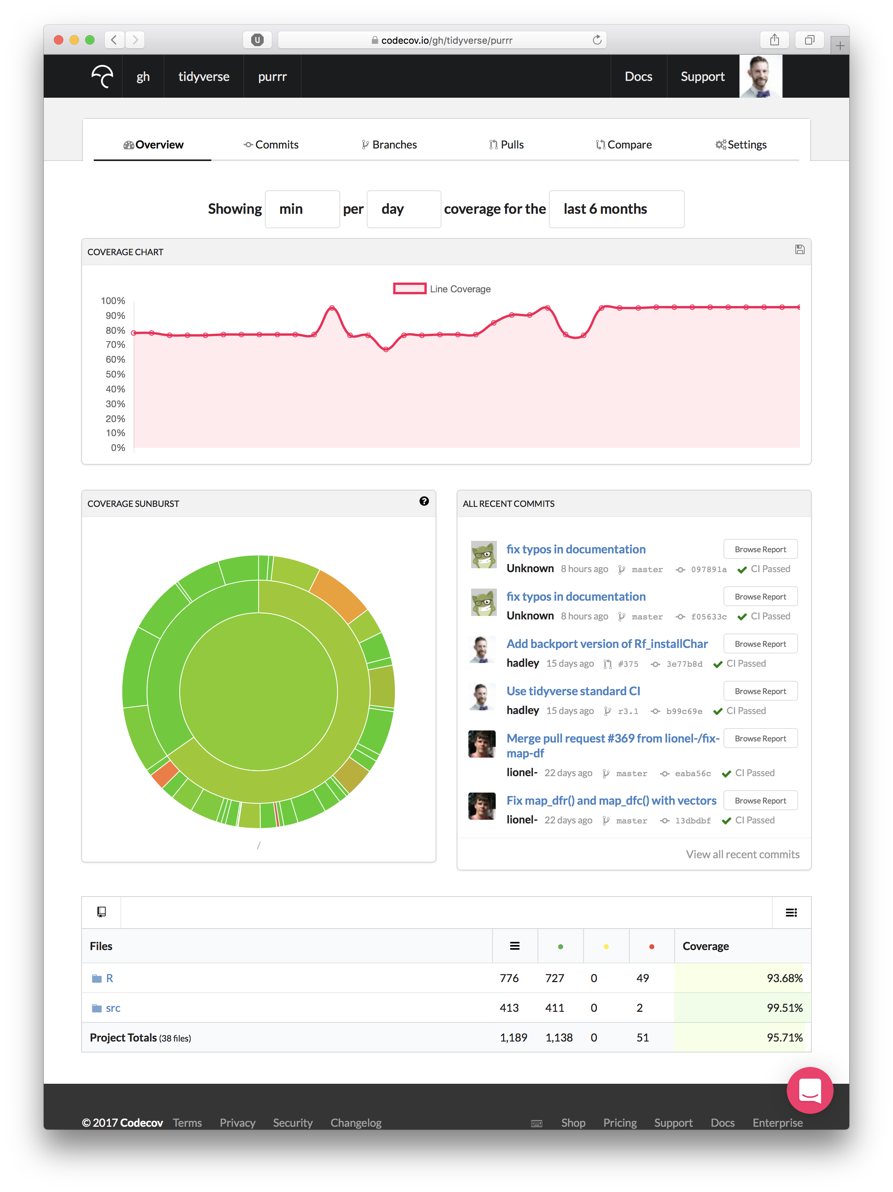

Slide 48
Ignore!
Click!

Slide 49
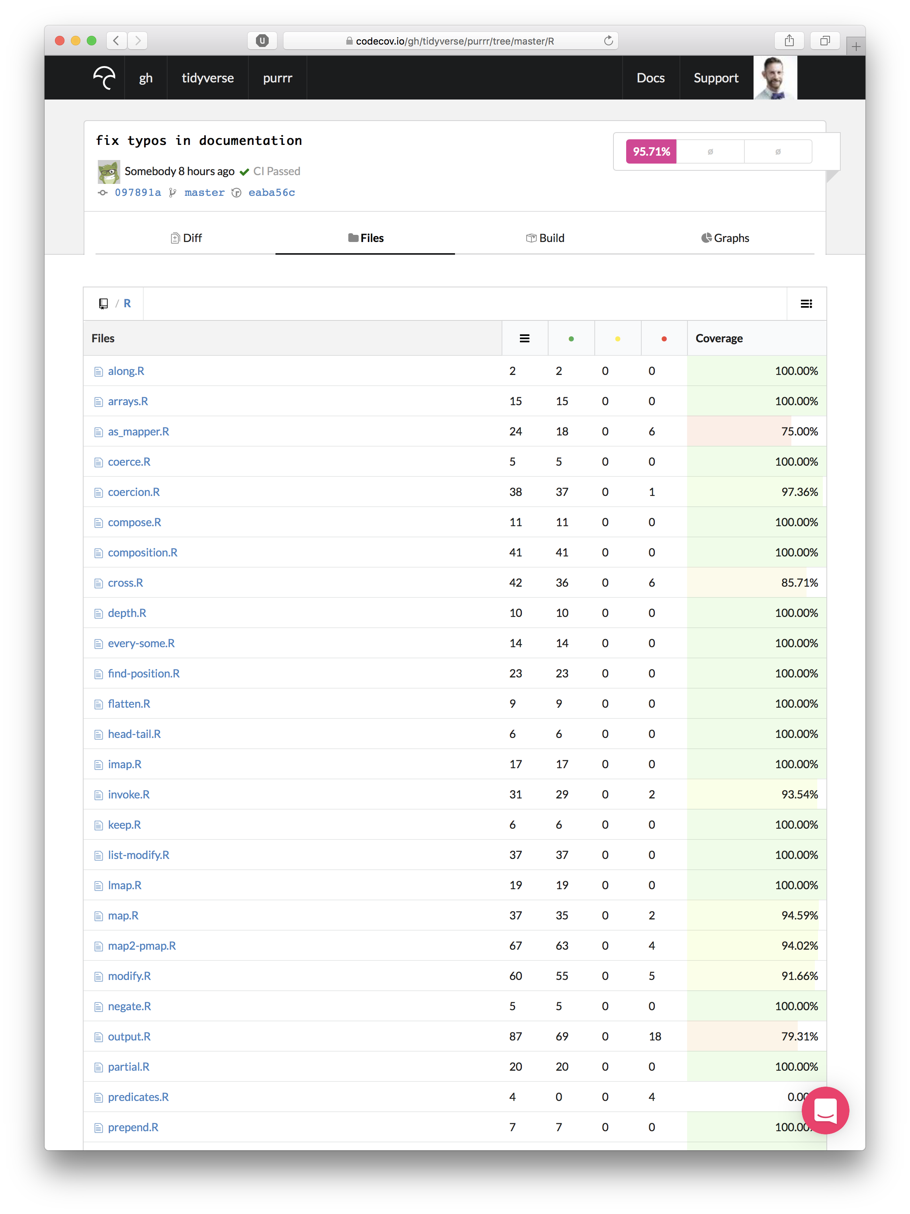

Slide 50
